Slide 1
WAF Trends and Analysis
Spark

Slide 2
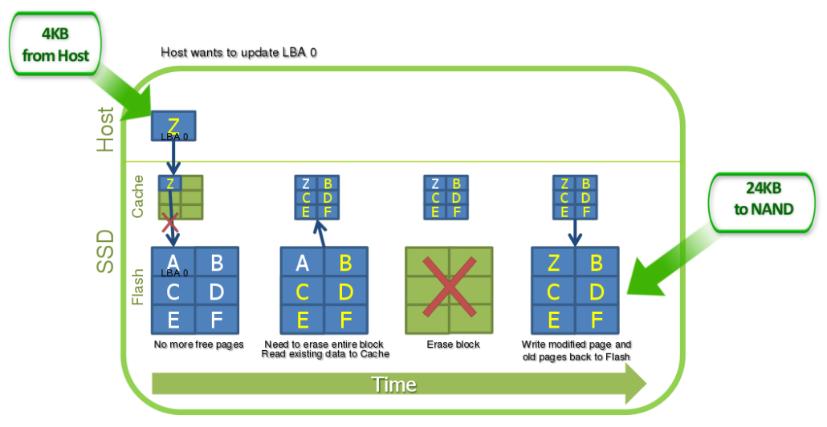
Purpose
Wear-leveling enhance
Free VB sort by erase count
GC target get Min-EC
Wear-leveling get Max-EC
Segment GC Flow
WAF trends stable
Trends analysis
Enlargement VB

Slide 3
Define
Define | Numbers
TOTAL_DIES | 4
BLOCKS_PER_DIE | 2000
PAGES_PER_BLOCK | 9
TOTAL_VB_PAGES | 36
TOTAL_PAGES | 7200
OP_SIZE | 7, 14, 28
TRIGGER_GC_VB | 9
URGENT_GC_VB | 3
Enlargement
Normal Case
Define | Numbers
TOTAL_DIES | 4
BLOCKS_PER_DIE | 200
PAGES_PER_BLOCK | 9
TOTAL_VB_PAGES | 36
TOTAL_PAGES | 7200
OP_SIZE | 7, 14, 28
TRIGGER_GC_VB | 9
URGENT_GC_VB | 3
Define | Numbers
TOTAL_DIES | 4
BLOCKS_PER_DIE | 200
PAGES_PER_BLOCK | 9
TOTAL_VB_PAGES | 36
TOTAL_PAGES | 7200
OP_SIZE | 7, 14, 28
TRIGGER_GC_VB | 6
URGENT_GC_VB | 3
Trigger VB

Slide 4
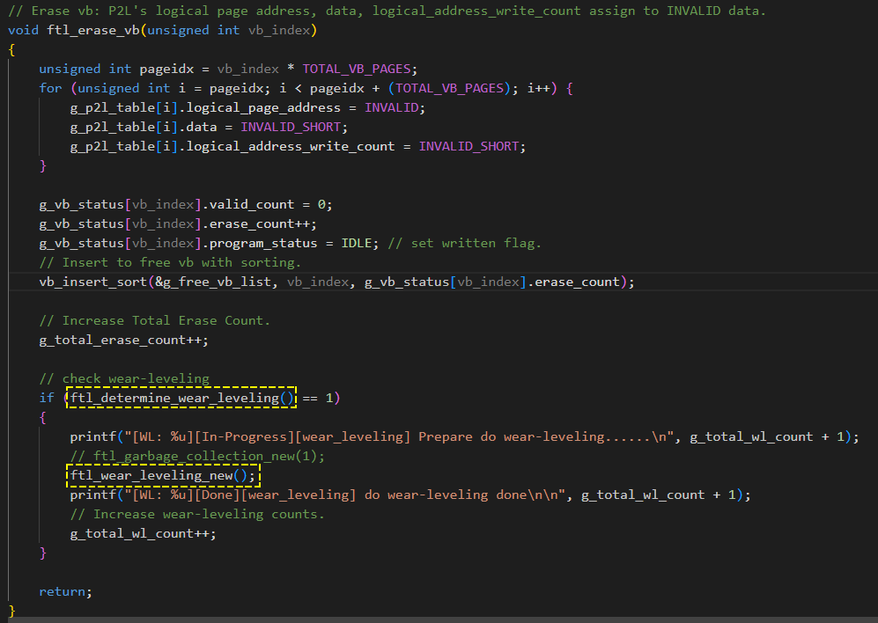
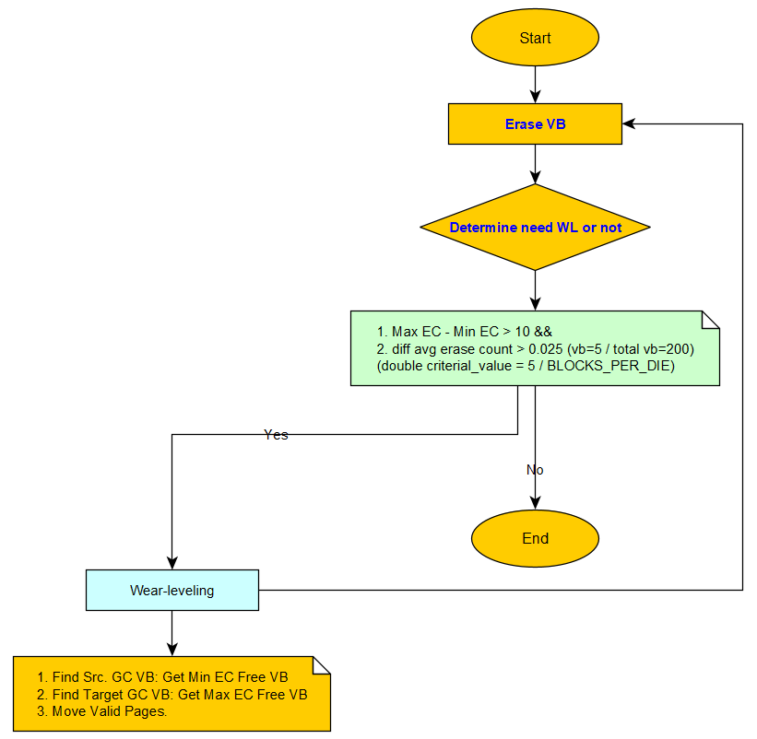
Wear-leveling trigger event

Slide 5
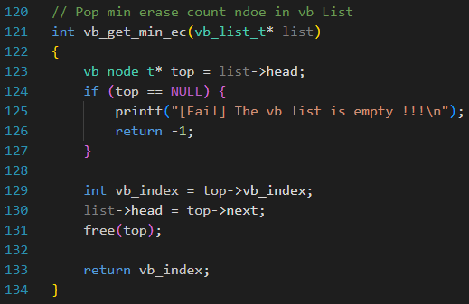
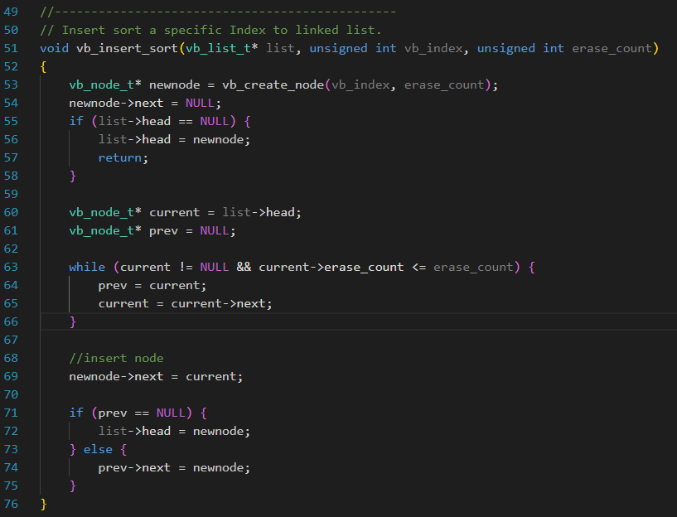
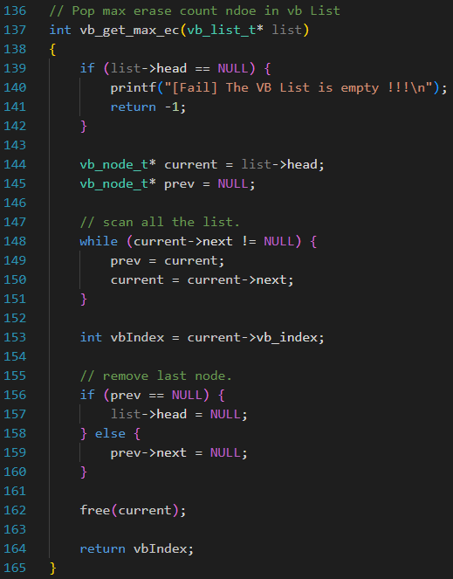
Insert free VB with sort
Get min ec for:
GC or Write
After Erase VB, and insert with sort:
Get max ec for:
Wear-Leveling

Slide 6
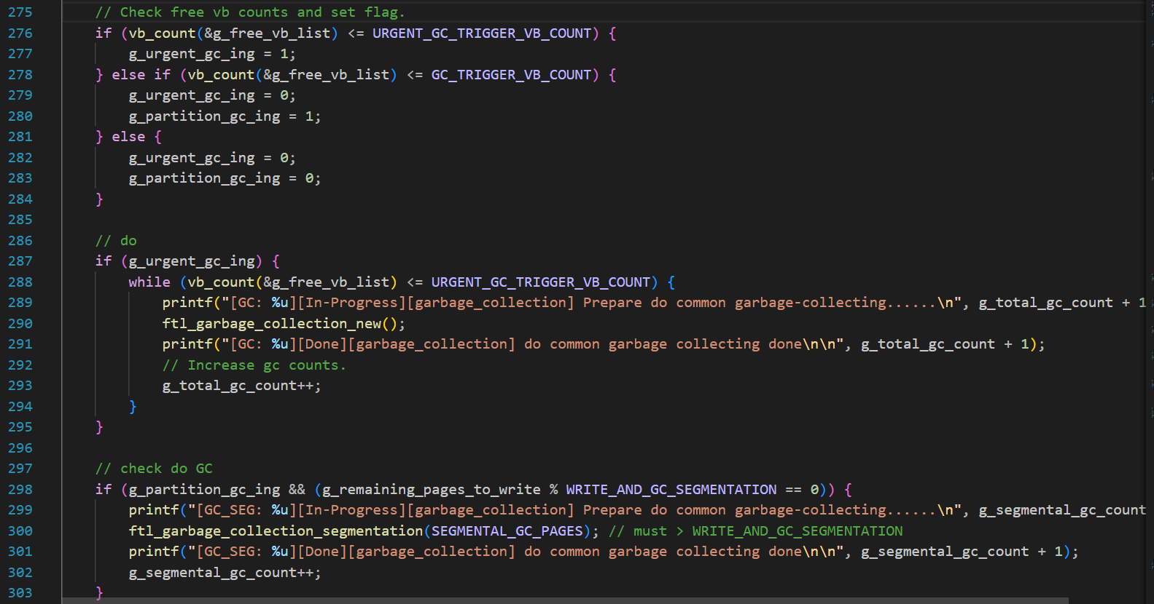
Segmental GC
條件1：在 Free VB 數量不夠時，Write 多少資料 (Pages) 觸發 GC 一次？
N Pages:４
條件2：每次進入 GC 要搬移多少 Valid Data (Pages)
Ｎ * 2 Pages: 8
Segmental GC 與 Normal GC 觸發點：
Segmental : Free VB <= 9
Normal : Free VB <= 3 (while)

Slide 7
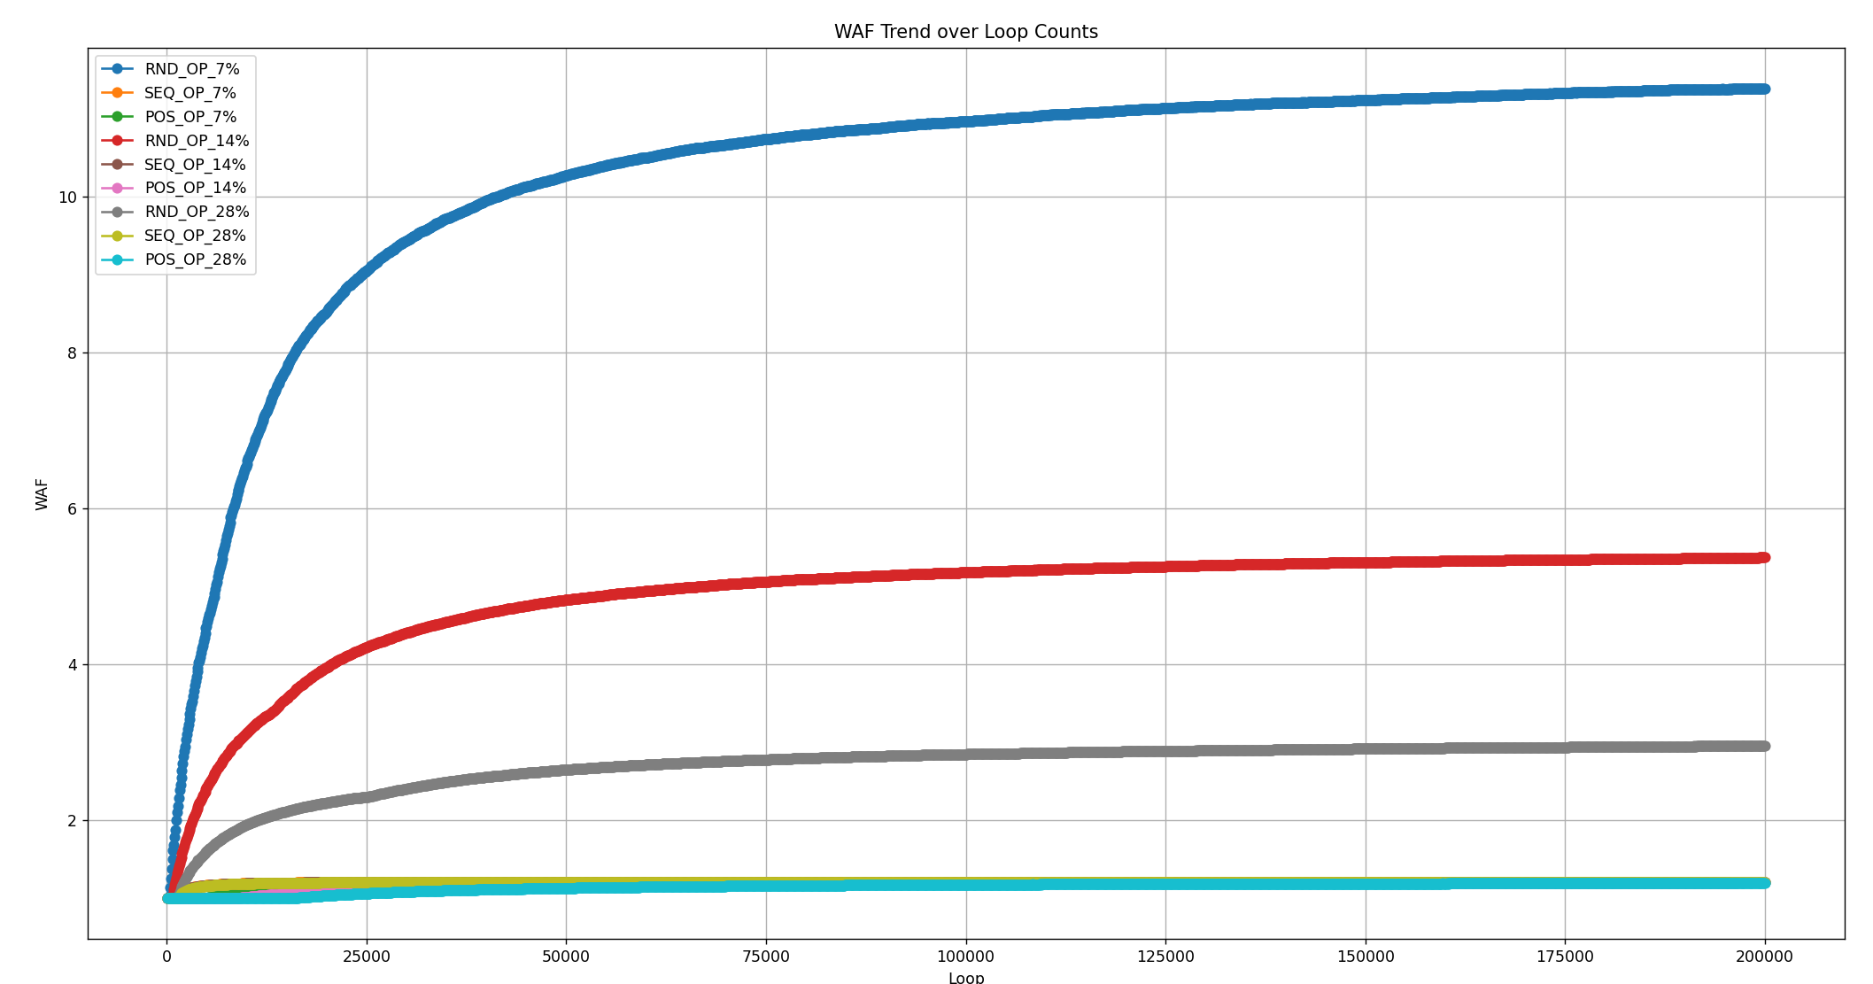
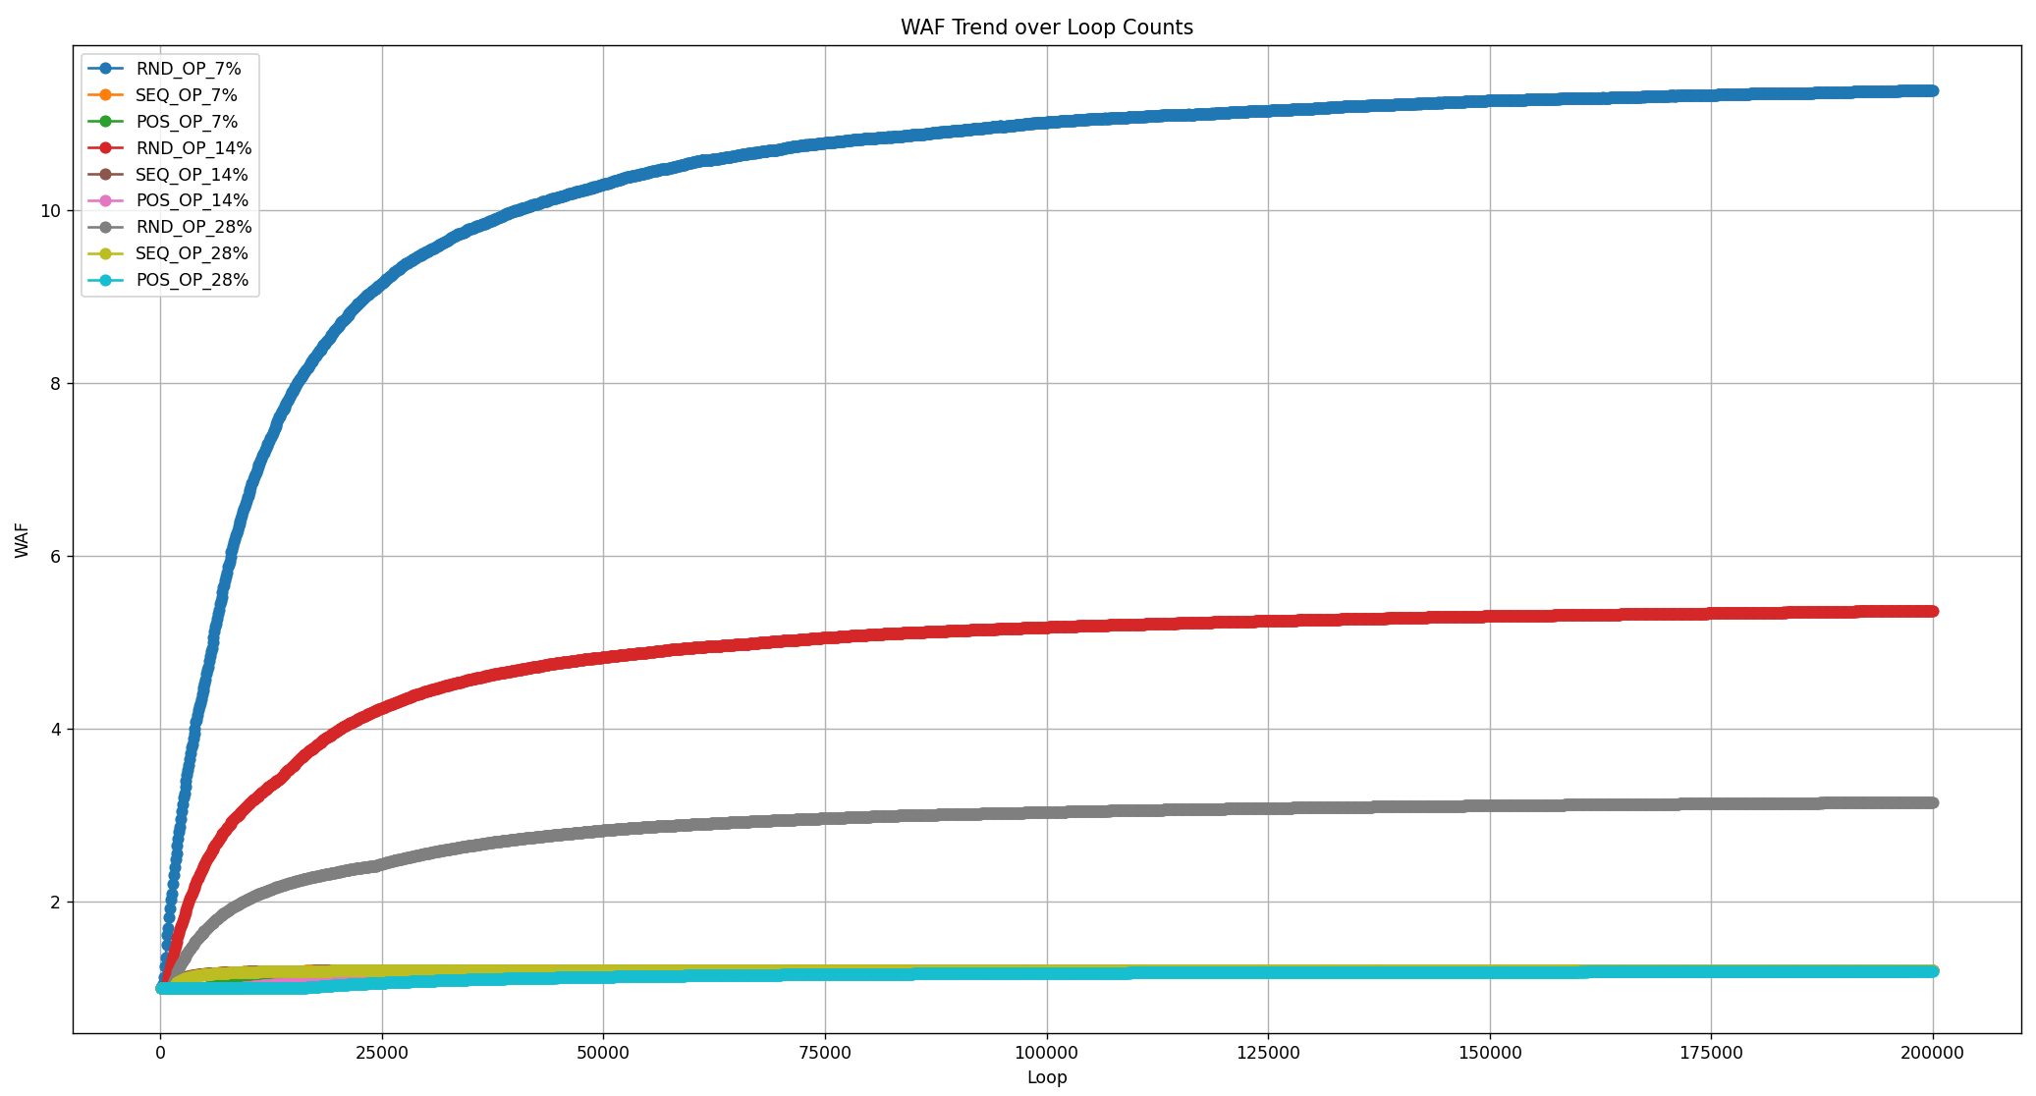
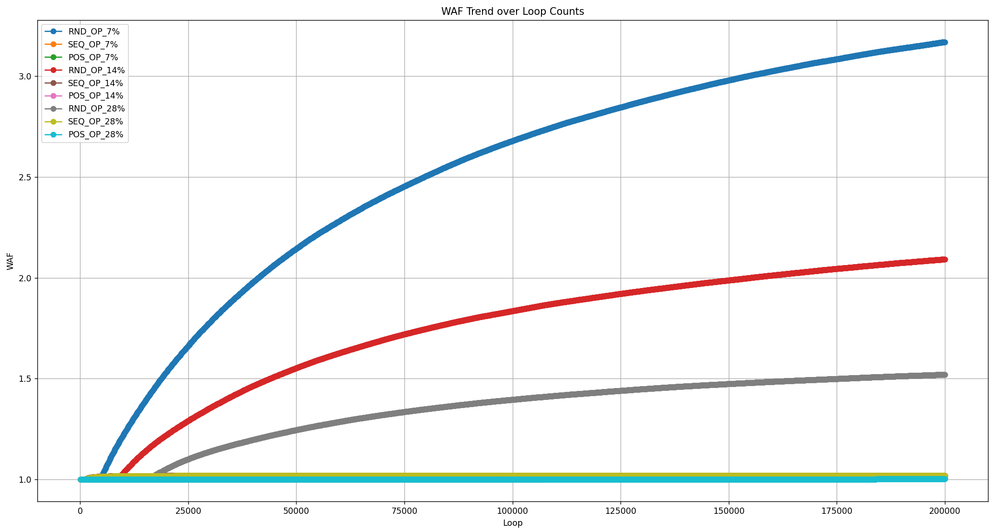
Test Result
尚未跑到收斂 → Block 數多，跑20萬次仍不夠，需增加次數。
一次 Random 測試需跑 10 分鐘以上
OP Size | VB = 200, GC = 6 | VB = 200, GC = 9 | VB = 2000, GC = 9
7% | 11.3844 | 11.38691 | 3.168148
14% | 5.370831 | 5.369333 | 2.091501
28% | 2.956785 | 3.151922 | 1.520773

Slide 8
How to prevent the negative effects of WAF
Ref: https://www.techtarget.com/searchstorage/definition/write-amplification-factor-WAF
Overprovisioning. Extra flash is added to the drive the user can't access. Overprovisioning facilitates data management and extends SSD endurance.
Error correction code (ECC). Bit errors are corrected with error correction code, extending the life of the drive.
Wear leveling. Wear leveling distributes P/E cycles across all blocks of the drive to prevent overuse of any one block.
Trim command. Old data is deleted faster with SSD Trim command, consolidating free space on a drive and enabling garbage collection at the page level rather than the block level.
Intelligent firmware. The program that runs an SSD and can manage the flash inside the drive to extend its life.

Slide 9
Thank You

